Slide 1
Communicative Vibration: A Graph-Theoretic Approach to Group Stability in an Online Social Network
Presented by:
Matthew Sweitzer, Robert Kittinger, Casey Doyle, Asmeret Naugle, Kiran Lakkaraju, Fred Rothganger, and Stephen Verzi
SAND No. 2020-7578 C

Slide 2




Communicative Vibration
Recent research has attempted to predict the stability or “vitality” of meso-level groups over time using a variety of sociometric data and methods, and with mixed success^{1, 2, 3, 4}
One of the most compelling and robust features indicative of group stability is intragroup communication
Communication among group members helps
coordinate group actions, convey social norms,
and can reinforce group identity^{5, 6}
However, prior ML research has largely focused on
communication frequency and has ignored the
structure of communication, both within a group
and between members of different groups

Slide 3
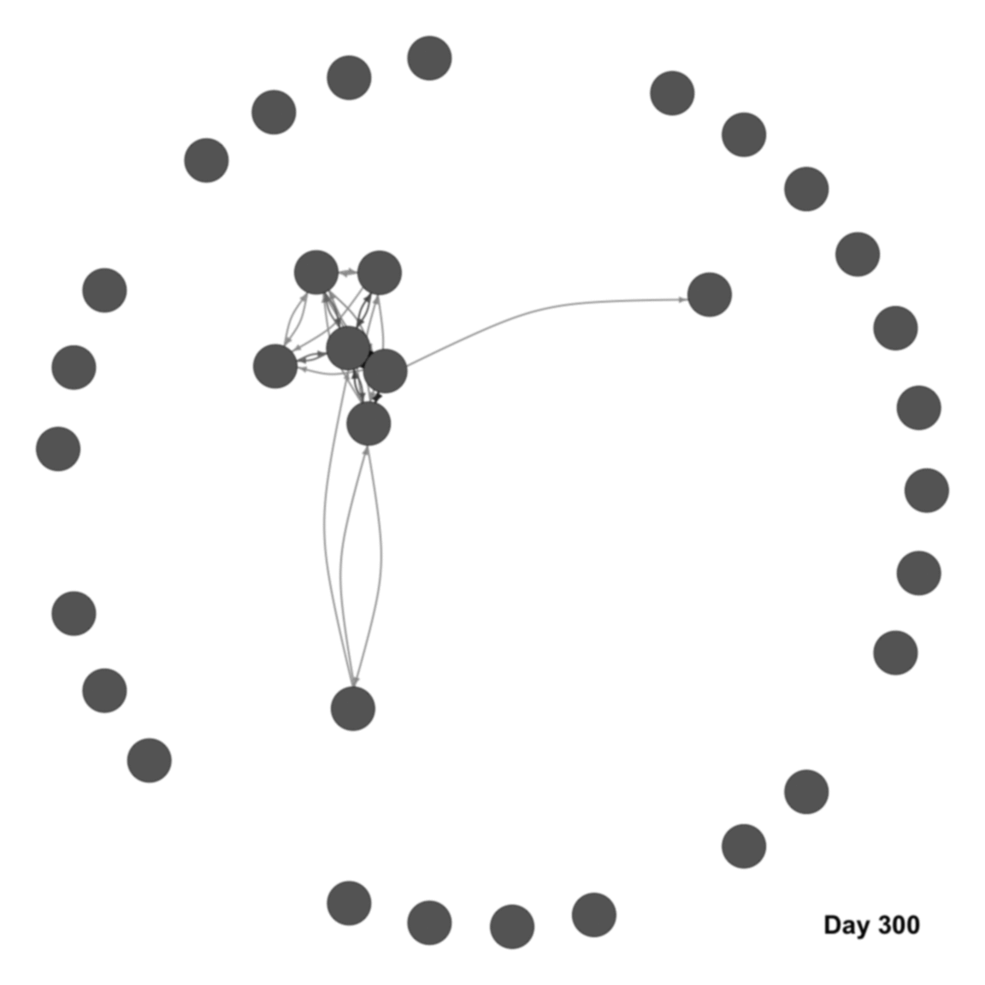
Communicative Vibration
Drawing from graph theory of social networks, we developed the concept of Social Vibration, or changes in the network graph position of people over time
Frequency of intra- and inter-group communication
Changes in the local and global structure of communication
A group’s connectedness
A group’s embeddedness in the broader community

Slide 4
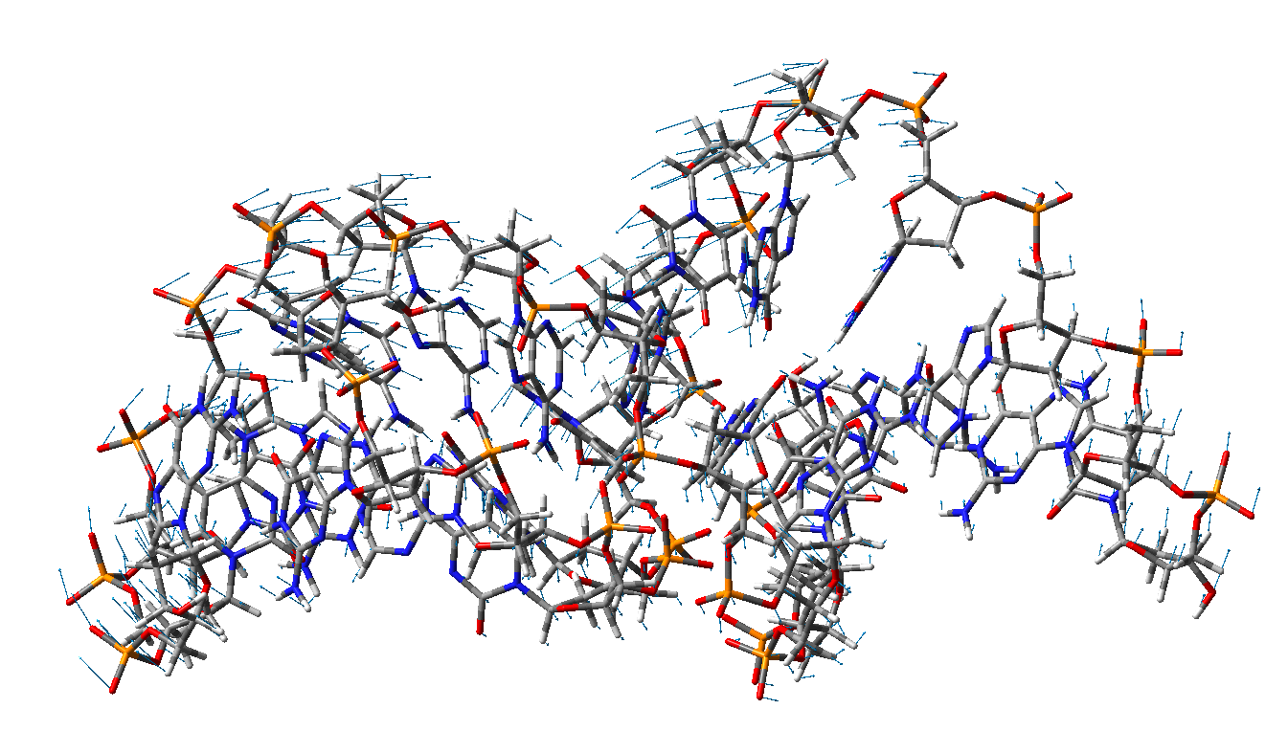
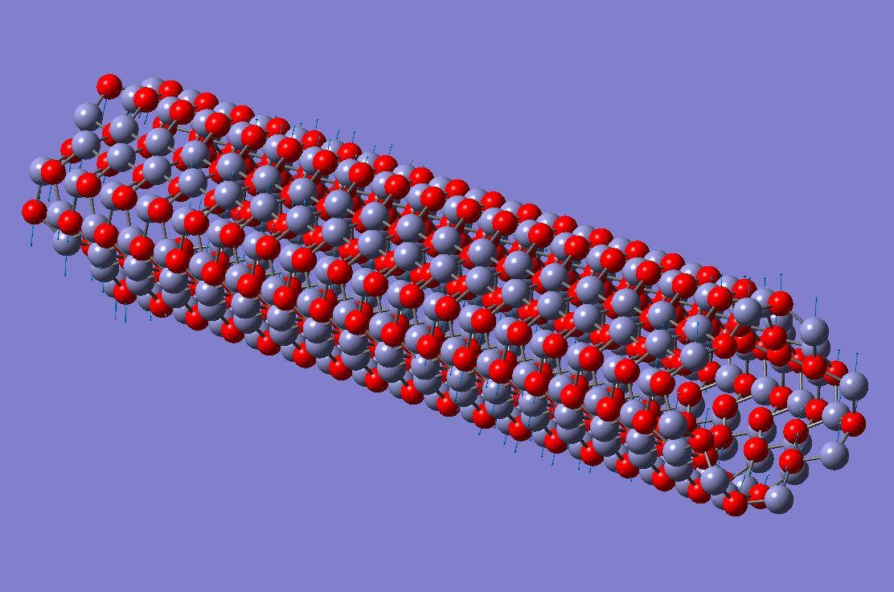
Communicative Vibration
Social vibration draws conceptually from the study of molecular vibration in materials science⁷; i.e., changes in the magnitude of the movement of molecules may be indicative of imminent structural failure of the material
Sudden changes in social relationships, both with whom one communicates and how frequently they exchange messages, may signal a social “phase change” in a group’s lifecycle
https://engweb.swan.ac.uk/~adhikaris/multiscale.html

Slide 5
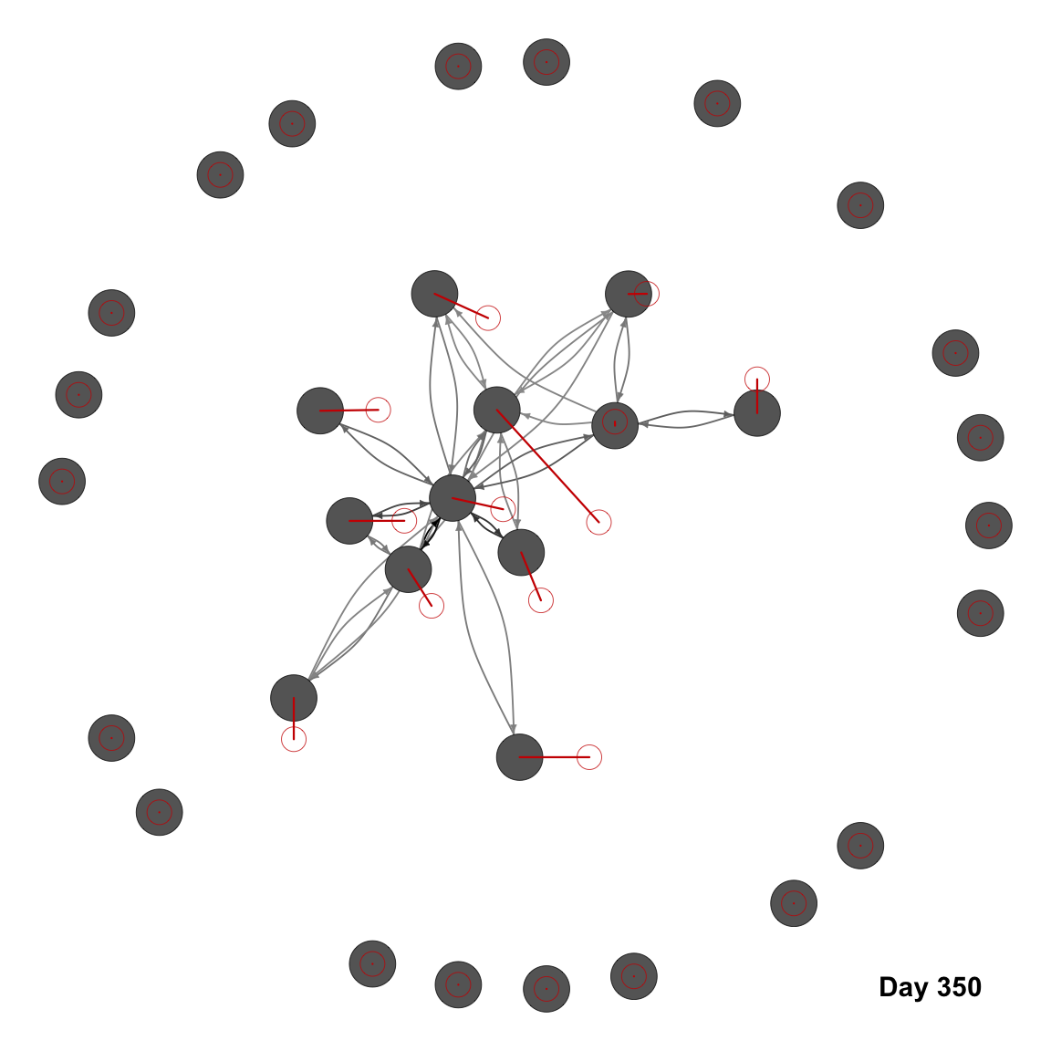
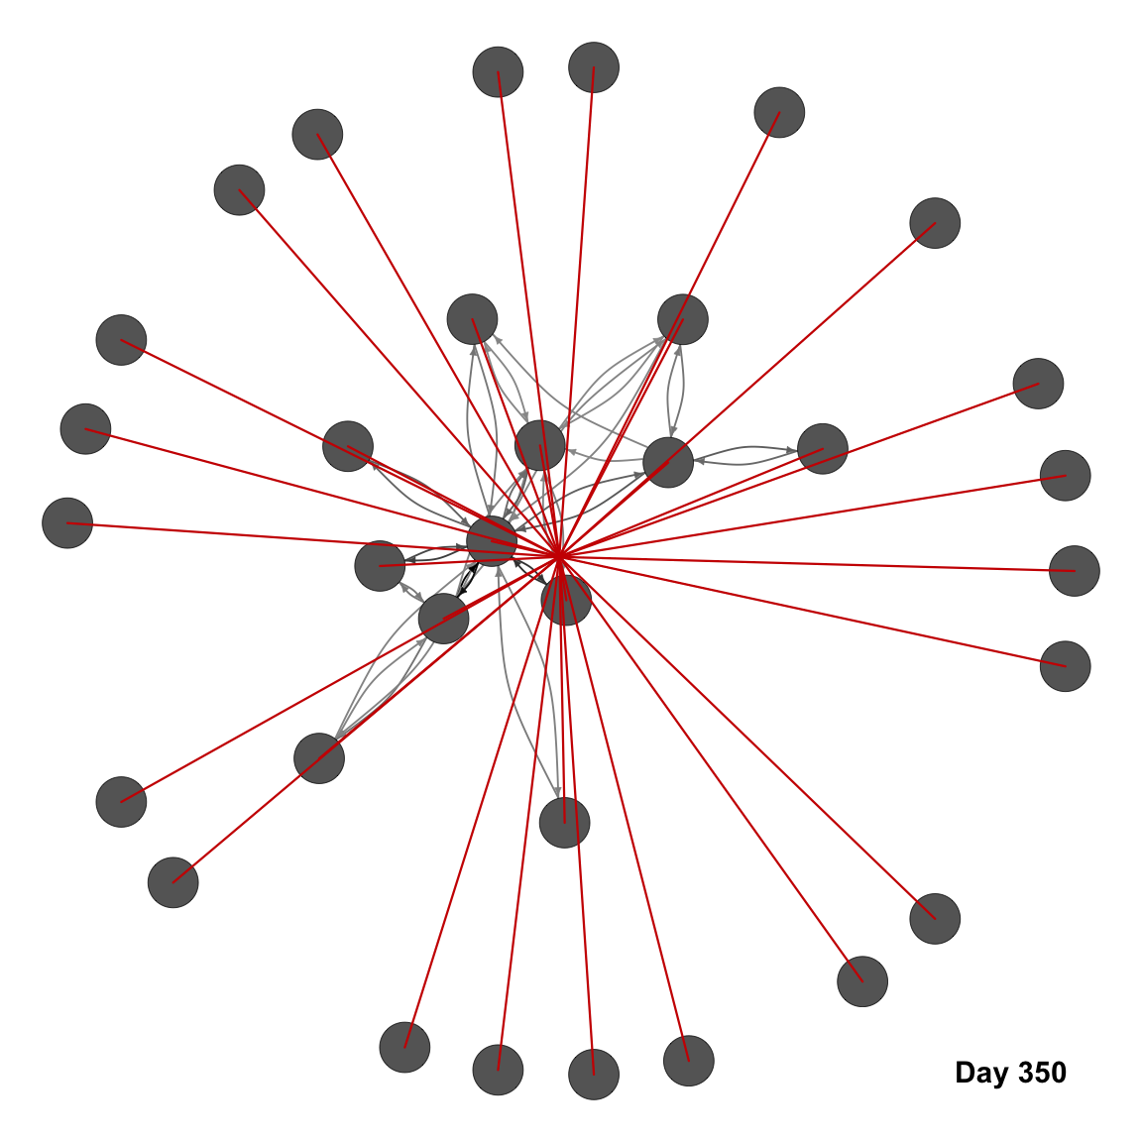
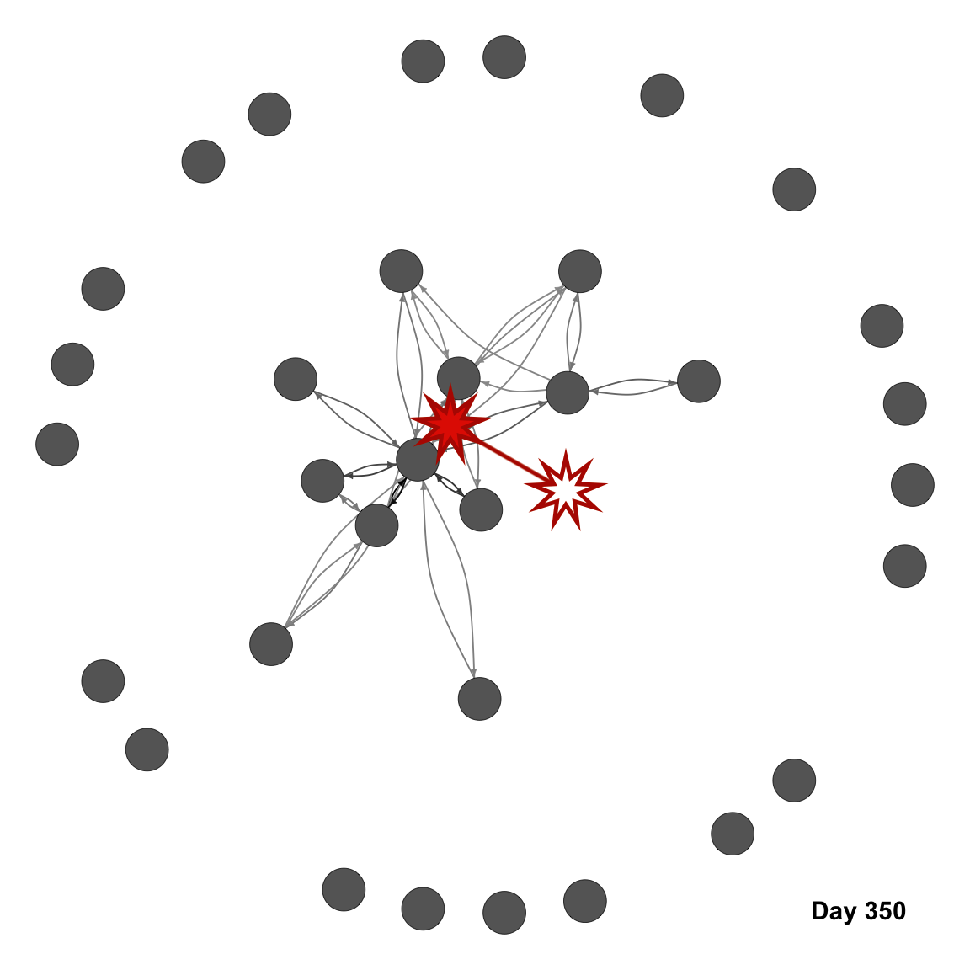
Communicative Vibration
Three measures of group vibration:
Average movement of members from day t-1 to t (MPP)
Reflects changes in both the frequency and structure of dyadic communication; both among group members and with non-members
Average distance between members and the group centroid on day t (MTC)
Measures changes in members’ participation in within-group communication as well as the structure of communication among group members
Movement of the centroid of group members from day t-1 to t (CPP)
Indicative of changes to the centrality or embeddedness of the group’s members relative to non-members
1
2
3

Slide 6
Communicative Vibration
Game X
Massively Multiplayer Online Role Playing Game (MMORPG)
Players can join explicit groups, “guilds”, to coordinate in-game resources, PvP and PvE combat, and other social interactions
Players can communicate with one another through (among other ways) a direct messaging system
Messages can be sent to both co-members and non-members of a player’s guild
2 years of daily, directed communication to construct 730 weighted networks; used all players with some activity (n = 18,806) across all networks, excluding those who both never join a guild and never send or receive a message
Network Construction
Communication networks were directed and weighted by number of messages
Graphs use a combination of a ring layout for isolates (positions randomly assigned) and the Fruchterman-Reingold⁸ layout for non-isolates (position at t-1 as priors)

Slide 7
Communicative Vibration
Guild Vibration
MPP, MTC, and CPP were all standardized within guilds (n = 365)
Guild Lifecycle - Stability
Guild birth – time at which the guild gains its first member
Guild death – time at which the guild loses its last member (n = 166)
Growth event – period of extraordinary increase in guild membership
Loss event – period of extraordinary decrease in guild membership
Merge event – period in which an extraordinary amount of members of one existing guild leave to join another existing guild

Slide 10
Communicative Vibration
Among guilds that die out before the end of data collection…
Members’ Prior Position
Group Centroid’s Prior Position
Members’ Distance to the Group Centroid
1-7 days prior | 1-14 days prior | 1-30 days prior
t(152) = -5.18; p<.001 | t(145) = -6.35; p<.001 | t(132) = -8.97; p<.001
-0.26 [-0.35, -0.16] | -0.26 [-0.34, -0.18] | -0.30 [-0.36, -0.23]
1-7 days prior | 1-14 days prior | 1-30 days prior
t(152) = -3.57; p<.001 | t(145) = -4.61; p<.001 | t(132) = -7.23; p<.001
-0.15 [-0.24, -0.07] | -0.16 [-0.23, -0.09] | -0.20 [-0.25, -0.14]
1-7 days prior | 1-14 days prior | 1-30 days prior
t(144) = 0.87; p=.39 | t(139) = 1.22; p=.23 | t(129) = 1.76; p=.08
0.07 [-0.08, 0.21] | 0.08 [-0.05, 0.21] | 0.11 [-0.01, 0.23]

Slide 11
Communicative Vibration
Among guilds that die out before the end of data collection…
Members’ Prior Position
Group Centroid’s Prior Position
Members’ Distance to the Group Centroid
1-7 days prior | 1-14 days prior | 1-30 days prior
t(152) = -5.18; p<.001 | t(145) = -6.35; p<.001 | t(132) = -8.97; p<.001
-0.26 [-0.35, -0.16] | -0.26 [-0.34, -0.18] | -0.30 [-0.36, -0.23]
1-7 days prior | 1-14 days prior | 1-30 days prior
t(152) = -3.57; p<.001 | t(145) = -4.61; p<.001 | t(132) = -7.23; p<.001
-0.15 [-0.24, -0.07] | -0.16 [-0.23, -0.09] | -0.20 [-0.25, -0.14]
1-7 days prior | 1-14 days prior | 1-30 days prior | 15-30 days prior
t(144) = 0.87; p=.39 | t(139) = 1.22; p=.23 | t(129) = 1.76; p=.08 | t(129) = 2.31; p<.05
0.07 [-0.08, 0.21] | 0.08 [-0.05, 0.21] | 0.11 [-0.01, 0.23] | 0.14 [0.02, 0.27]

Slide 12
Communicative Vibration
Next Steps:
Implement some form of machine learning or time series analysis
Deal with imbalance in classification
Identify other group-level outcomes of interest
Ideally compare predictive power of vibration against other feature vectors (e.g., age of the group, game experience points, diversity of player characteristics, etc.)
Sweep parameters of the layout algorithm
Ensure vibration is robust across starting conditions
Compare random ring layout against membership-informed layout
Test vibration theory on other data sets
Do findings hold in other contexts?
Attempt prediction when group death (or other outcomes) aren’t yet known

Slide 13
References
[1] A. Patil, J. Liu, and J. Gao, “Predicting group stability in online social networks,” in Proceedings of the 22nd international conference on World Wide Web, pp. 1021–1030, 2013.
[2] S. Saganowski, B. Gilwa, P. Bródka, A. Zygmunt, P. Kazienko, and J. Koźlak, “Predicting community evolution in social networks,” Entropy, vol. 17, no. 5, pp. 3053–3096, 2015.
[3] A. Sharma, R. Kuang, J. Srivastava, X. Feng, and K. Singhal, “Predicting small group accretion in social networks: A topology based incremental approach,” in Proceedings of the 2015 IEEE/ACM International Conference on Advances in Social Networks Analysis and Mining, pp. 408–415, 2015.
[4] M. Takaffoli, R. Rabbany, and O. R. Zaïane, “Community evolution prediction in dynamic social networks,” in Proceedings of the 2014 IEEE/ACM International Conference on Advances in Social Networks Analysis and Mining, pp. 9–16, 2014.
[5] L. Festinger, “Informal social communication,” Psychological Review, vol. 57, no. 5, pp. 271–282, 1950.
[6] R. Spears, and M. Lea, “Panacea or panopticon?: The hidden power in computer-mediated communication,” Communication Research, vol. 21, no. 4, pp. 427–459, 1994.
[7] T. More, “Group theory, molecular vibrations and electron transitions,” in Symmetry and group theory in chemistry (M. Ladd, ed.), Horwood Chemical Science Series, pp. 221–247, Chichester, UK: Horwood Publishing, 1998.
[8] T. M. J. Fruchterman and E. M. Reingold, “Graph drawing by force-directed placement,” Software: Practice and experience, vol. 21, no. 11, pp. 1129–1164, 1991.

Slide 14
Communicative Vibration

Slide 15
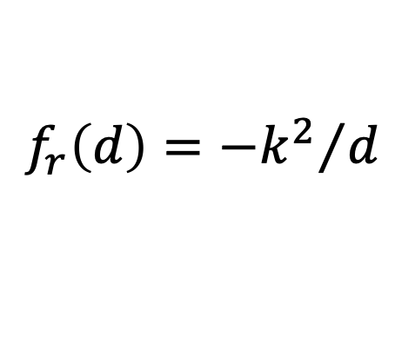
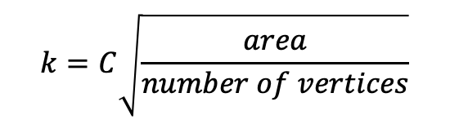
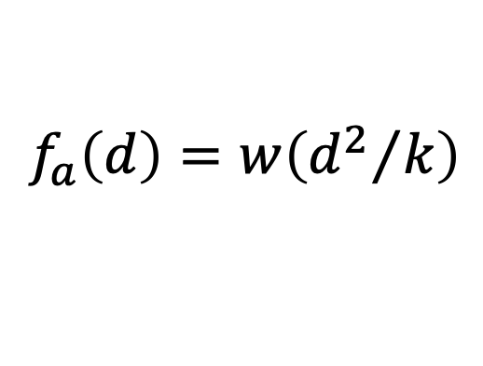
Communicative Vibration
Fruchterman-Reingold uses a force-directed calculation to move vertices into an optimal position in a graph
Three-step process:
Place nodes in a starting position (ring or prior day)
Calculate attraction and repulsion forces to produce a vector and acceleration
Move nodes to their new position (limited by temperature)
Iterate over steps 2 and 3 using a temperature and cooling schedule
$$f_{a}\left(d\right)=w\left({d^{2}}/k\right)$$
Attractive forces:
Repulsive forces:
$$f_{r}\left(d\right)={{−k}^{2}}/d$$
w is the weight of the edge (# messages)
d is the distance between nodes in the plotting space
$$k=C\sqrt{\frac{area}{number of vertices}}$$

Slide 19
Communicative Vibration
Among guilds that die out before the end of data collection…
Members’ Prior Position
Group Centroid’s Prior Position
Members’ Distance to the Group Centroid
1-7 days prior | 1-14 days prior | 1-30 days prior | 15-30 days prior
t(152) = -5.18; p<.001 | t(145) = -6.35; p<.001 | t(132) = -8.97; p<.001 | t(132) = -8.70; p<.001
-0.26 [-0.35, -0.16] | -0.26 [-0.34, -0.18] | -0.30 [-0.36, -0.23] | -0.31 [-0.38, -0.24]
1-7 days prior | 1-14 days prior | 1-30 days prior | 15-30 days prior
t(152) = -3.57; p<.001 | t(145) = -4.61; p<.001 | t(132) = -7.23; p<.001 | t(132) = -7.71; p<.001
-0.15 [-0.24, -0.07] | -0.16 [-0.23, -0.09] | -0.20 [-0.25, -0.14] | -0.22 [-0.28, -0.16]
1-7 days prior | 1-14 days prior | 1-30 days prior | 15-30 days prior
t(144) = 0.87; p=.39 | t(139) = 1.22; p=.23 | t(129) = 1.76; p=.08 | t(129) = 2.31; p<.05
0.07 [-0.08, 0.21] | 0.08 [-0.05, 0.21] | 0.11 [-0.01, 0.23] | 0.14 [0.02, 0.27]

